Slide 1

PLASMONIC SENSOR FOR RAPID DETECTION OF WATER IN HONEY AND QUANTITATIVE MEASUREMENT OF LACTOSE CONCENTRATION IN SOLUTION
Name: Vimaleswar A
Roll No: 20305
Instructor: Mitradip Bhattacharjee

Slide 2
Introduction
Surface Plasmon Resonance (SPR) emerges as a pivotal technique for measuring the refractive index (RI) of molecules, rooted in the principle of surface plasmon polaritons (SPPs).
SPPs, are wavy motions that happen when light interacts with certain surfaces.
These motions help to control and focus light in very small spaces, even smaller than what normal optical devices can manage. This means we can see tiny details that we couldn't see otherwise.
Plasmonic sensors, particularly those utilizing metal-insulator-metal (MIM) waveguides, stand out for their strong light confinement, economical fabrication, and various advantageous features.
They offer real-time, label-free detection with high sensitivity and selectivity, catering to diverse sensing applications such as biosensors and chemical sensors.
Moreover, they exhibit rapid response times, portability, and ease of integration into microfluidic chips, promising advancements in modern biosensors.

Slide 3
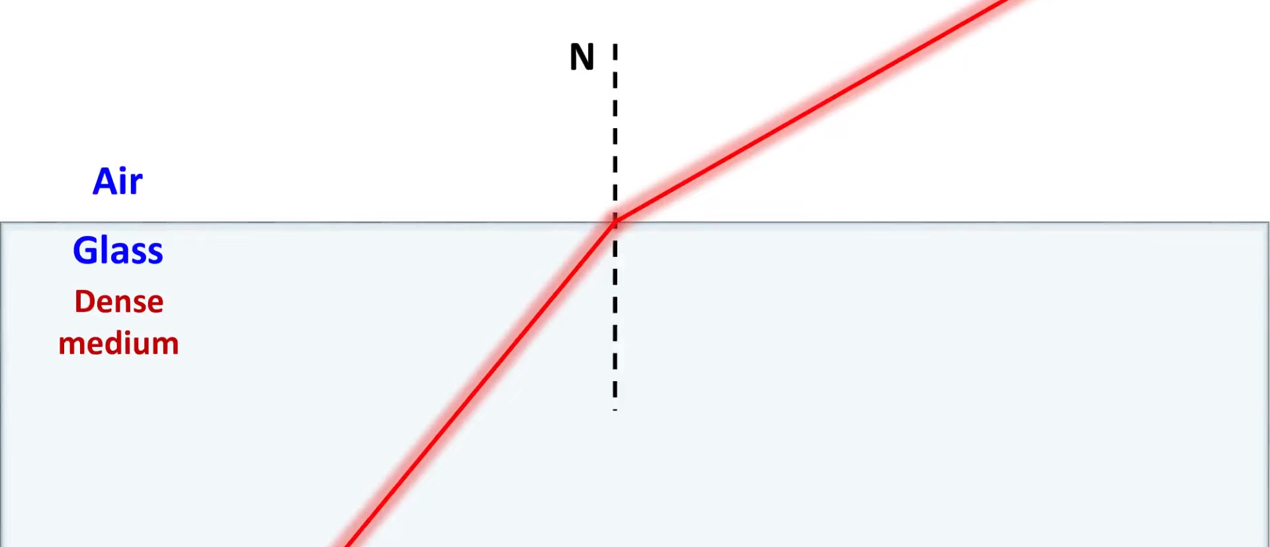
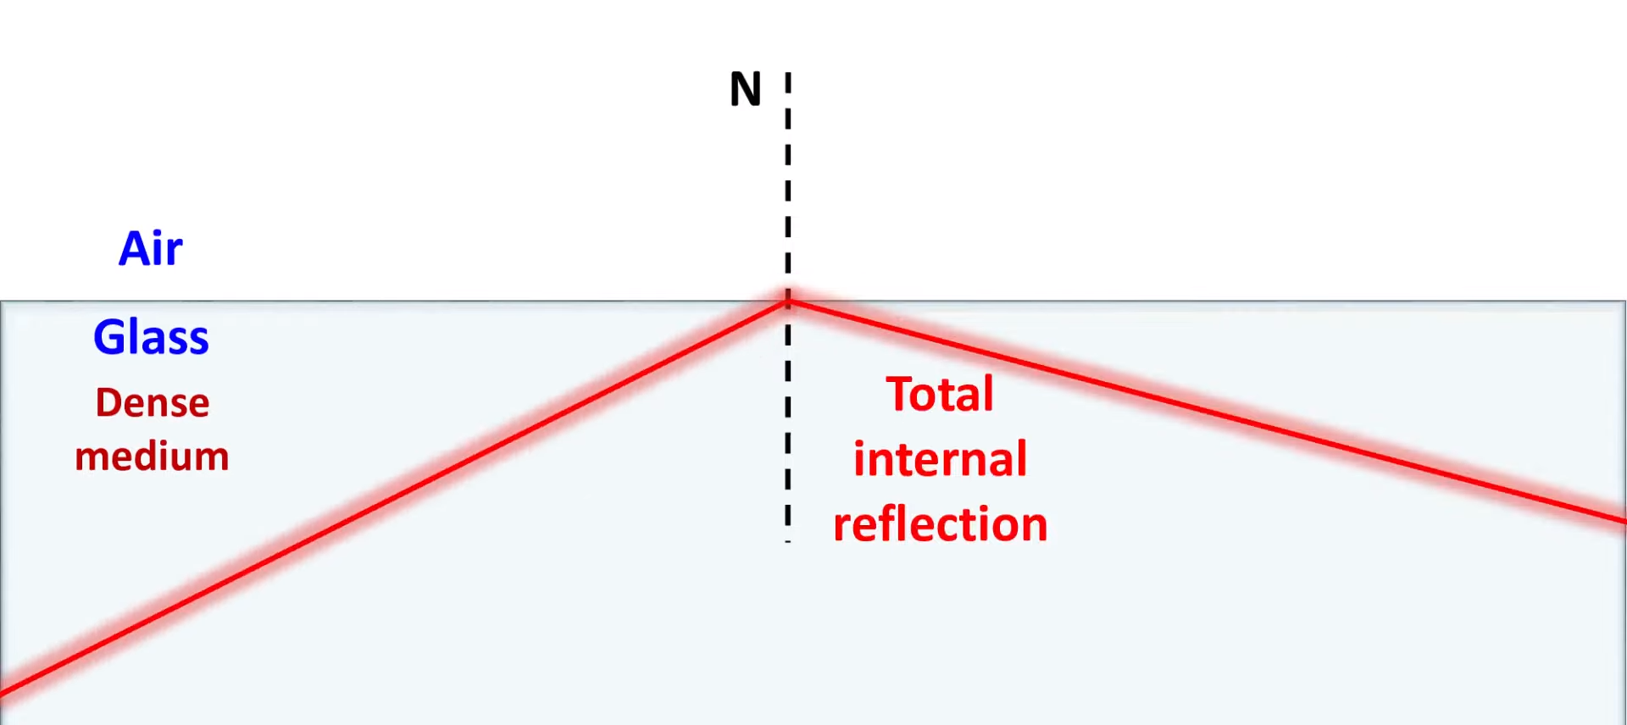
Working Principle
Surface Plasmon Resonance is an optical technique used to study and measure molecular interactions in real time
Light moves from denser medium to a light medium such like from glass to air it moves away from the normal.
Total internal reflection occurs when an angle of incidence greater than the critical angle. At this critical angle, the light ray is no longer refracted out of the medium but is instead reflected back into the same medium.

Slide 4
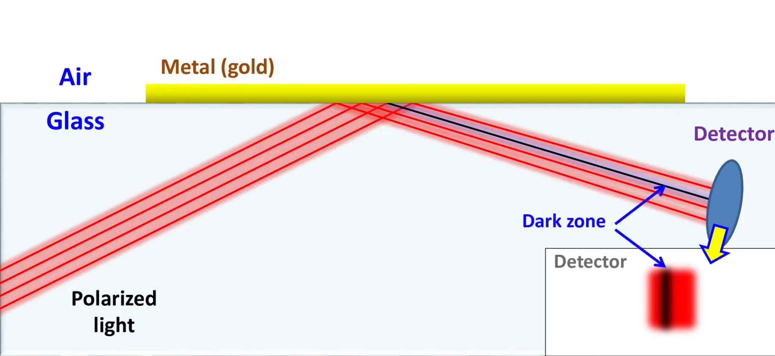
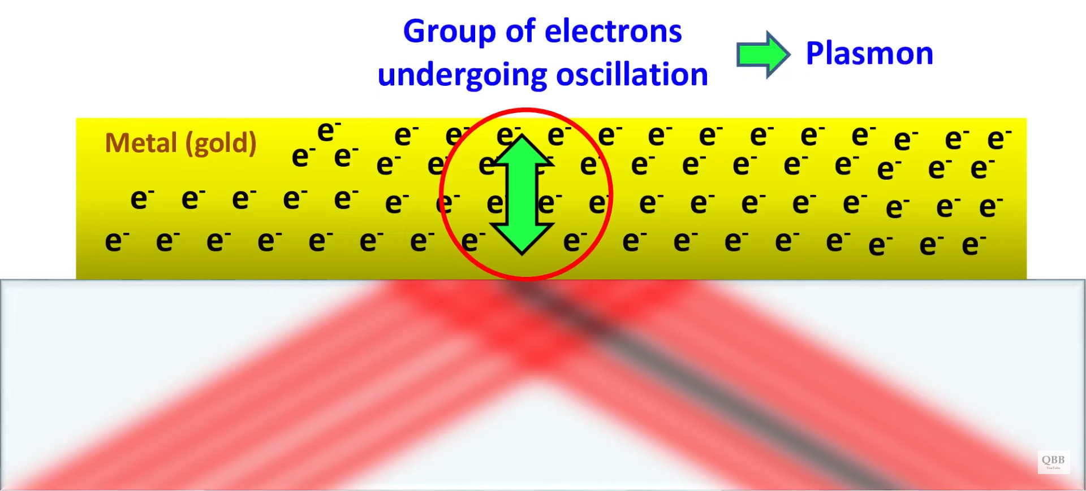
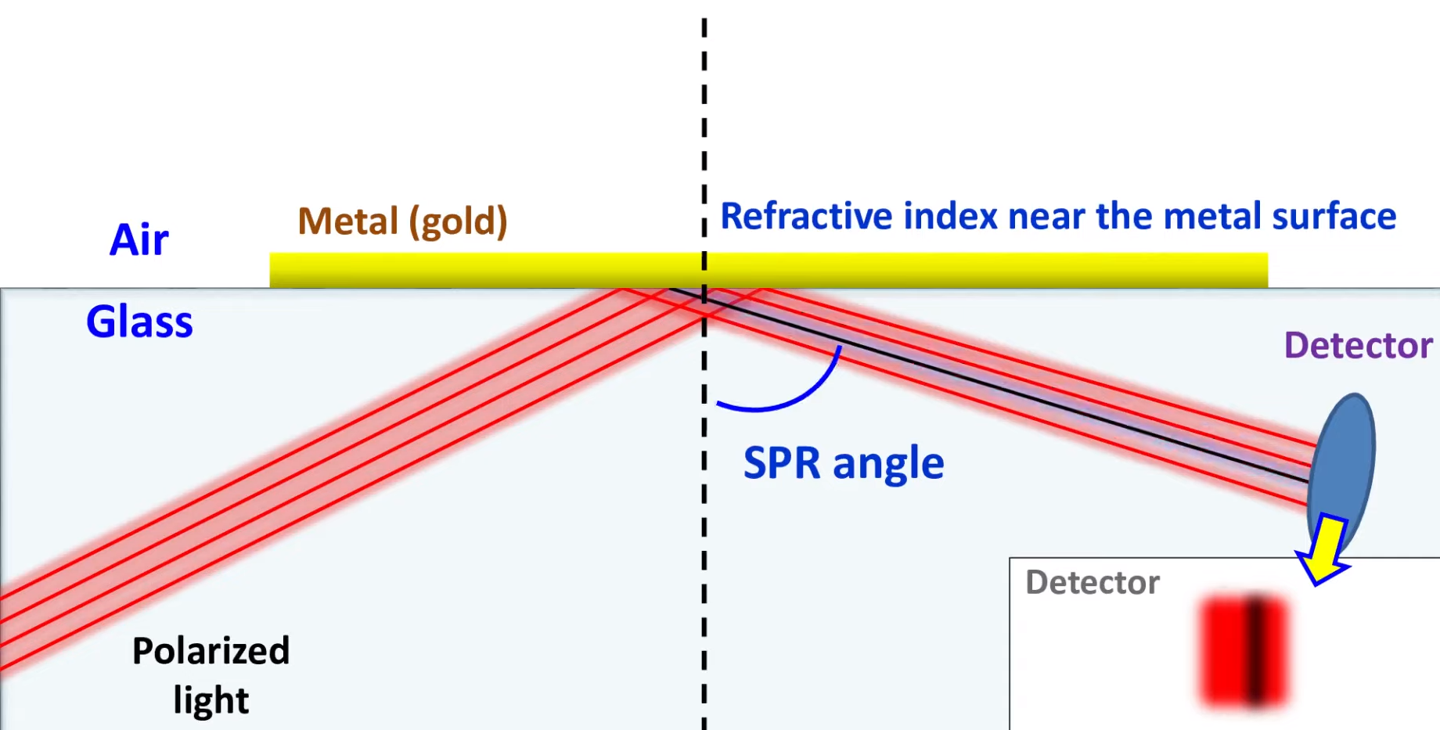
Plain Polarized Light undergo TIR if a thin metal plate is place on the top then some part of the refracted light is absorbed using detector. As a result dark zone appears in the refracted light.
This absorption of light is carried out by group of electrons present in the metal. These electrons undergo oscillation because of absorption energy of light. This phenomenon is called as Plasmon.
Surface Plasmon Resonant (SPR) angle depends on the refractive index of the medium near the metal surface and any change will cause changes in SPR angle.

Slide 5
Sensor Performance parameters
Sensitivity (S) is a measure of the change in resonant wavelength in response to the change in the refractive index of the dielectric material. Mathematically,
Where, 𝑑𝜆_{𝑟𝑒𝑠} is the change in resonant wavelength and 𝑑𝑛 denotes the change in refractive index (𝜆_{𝑟𝑒𝑠} = 2_{neff} 𝐿 / (𝜓 − 𝜙_{𝑟𝑒𝑓} / Pi)
𝑆 = 𝑑𝜆_{𝑟𝑒𝑠}/𝑑_{𝑛}
The transmittance spectrum of the MIM waveguide can be obtained through the FEM analysis which can be expressed as
Where, 𝑆₂₁ is the coefficient of transmission from input port A to output port B of the MIM waveguide
𝑇 = 𝑆^2 ₂₁
Sensing resolution (SR) describes the smallest shift of the refractive index of the unknown material that can be detected by the sensor
𝑆𝑅 = 𝑑_{𝑛} × 𝛥𝜆 / 𝑑𝜆_{𝑟𝑒𝑠}
Where, 𝛥𝜆 denotes the wavelength resolution of the spectrum analyzer. The analyzers have a typical value of 𝛥𝜆 = 0.001 nm

Slide 6
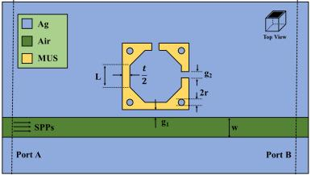
Sensor Geometry / Structure
The proposed geometric structure of the sensor is illustrated in a 2-D top view.
It consists of a straight MIM waveguide coupled with an octagonal cavity resonator inside a square disk along with silver nanodots and two slits.
The material under sensing (MUS) is used as the insulator medium in the sensor
The sensing performance parameters i.e. Transmittance, Sensitivity, and SR vary depending on the structure of the resonator. These parameters are sensitive to the change of any geometric parameter. In order to achieve optimal transmittance and sensitivity, the geometric parameters are tuned and evaluated in an iterative approach.
L - Length of the arm of octagon
w - Width of the waveguide
t - Distance between outer square and inner octagon
g1 - Gap between waveguide and resonator
g2 - Width of the slit/hole
r - Radius of the nanodots

Slide 7
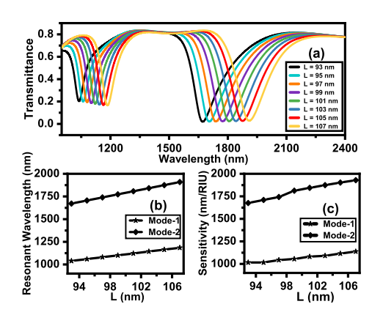
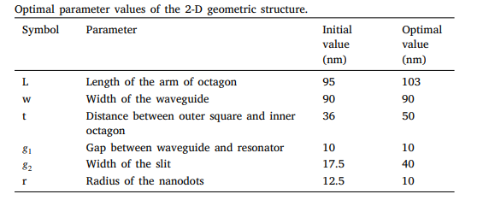
Consider two observed dips in the transmittance characteristics curve are considered mode 1 and mode 2 respectively. The optimization is carried out when the refractive index of the sensing medium is chosen as n = 1.
The first parameter considered for tuning is the length of the arm of the octagon (L).
The initial dimension was 95 nm. For the initial dimension, the sensitivity for mode 1 and mode 2 are 1016.463 nm/RIU and 1709.63 nm/RIU. The value of the parameter L was varied from 93 nm to 107 nm and eight equally distant values were taken in between the limits. Upon observing the change in performance parameters when the length of the octagon is 103 nm the corresponding sensitivity for mode 1 and mode 2 are 1085.49 nm/RIU.

Slide 8
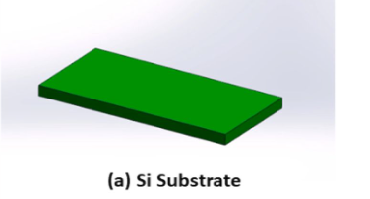
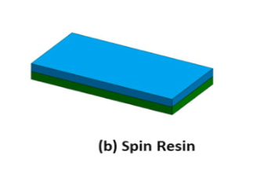
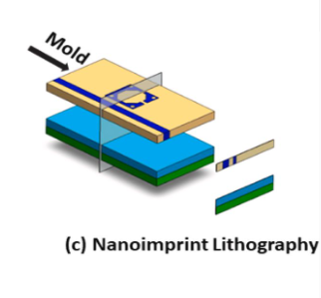
Fabrication methods
Nanoimprint Lithography (NIL) is one of the techniques for manufacturing plasmonic nanosensor.
The NIL fabrication process begins by taking a Si substrate.
Next, we carefully place polymethylmethacrylate (PMMA) resin onto a silicon (Si) substrate.
Followed by the transfer of the desired mold design onto the resin layer.
Successful imprinting requires applying a temperature exceeding 170°C and a substantial pressure of 50 bars.

Slide 9
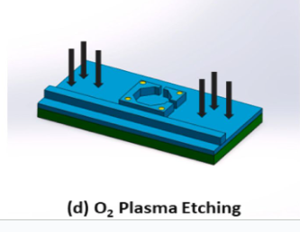
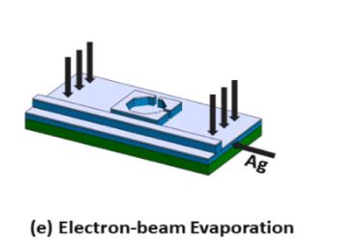
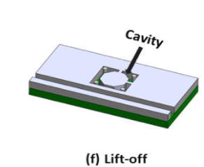
During imprinting, the resin layers thickness remains consistent in designed areas, while excess resin accumulates in areas of diminished thickness.
An oxygen plasma etching technique is employed to remove excess resin by subjecting the layer to an oxygen flow rate of 30 mL per minute and a power of 300 W for 6 minutes.
An additional layer of silver (Ag) is deposited onto the substrate surface using electron-beam evaporation.
Finally, the imprint resin is eliminated by subjecting the substrate to ultrasonic agitation in acetone.

Slide 10
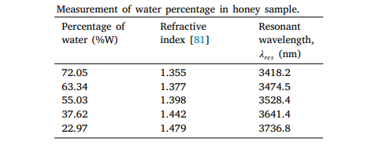
Result Analysis
After the optimization of geometric parameters, the sensitivity values of mode 1 and mode 2 are 1344.11 nm/RIU and 2527.6 nm/RIU respectively. The sensing resolution of mode 2 is 3.956 × 10−7 RIU which implies that the sensor is capable of detecting minuscule changes in the refractive index of an unknown material.
Detection of water in honey
Honey is one of nature’s most complex carbohydrate compounds.
Water is one of the most commonly used adulterants found in honey.
The percentage of water can be calculated from the measured refractive index using the following equation,
%𝑊 = 608.277 − 395.743 × n
Where, 𝑛 is the refractive index of the honey sample

Slide 11
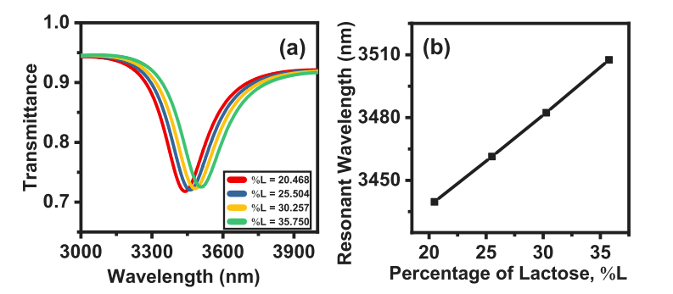
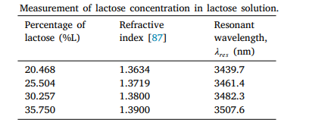
Measurement of lactose concentration in solution
Lactose is a molecule consisting of glucose and galactose monosaccharides. It is mostly found in milk and other milk-based product.
The percentage of lactose at room temperature can be calculated from the equation as follows
𝑛 = 1.3325 + 0.001384 × %𝐿 + 0.00000624 × %𝐿 2
Here, 𝑛 is the refractive index of the lactose solution and %𝐿 is the percentage of lactose present in the solution.
Since the second-order coefficient is significantly small, the relationship between the refractive index and the lactose concentration is almost linear.

Slide 12
Conclusion
In this paper, a novel design of a refractive index sensor with a MIM waveguide and an octagonal cavity resonator inside a square disk along with silver nanodots and two slits has been proposed and numerically investigated.
The simulation studies suggest that the sensor design achieves maximum sensitivity of 2527.6 nm/RIU.
The sensor has also been further scrutinized to test its ability to measure water concentration in honey and lactose concentration in lactose solution which implies that the proposed sensor can be used to detect the quality of honey and detect lactose in food products.
As the development of plasmonic sensors is going on, the designed sensor shows great potential of contributing to the food quality monitoring sector.
Thank You

